Slide 1
Patient Registration System
Submitted by:- Submitted to :-
Preekshit Dahiya Mr. Tejpal
2019214 IT workshop

Slide 2

Content
Objective.
Introduction.
Features and Scope.
Functions, Classes and Libraries.
Output.
Conclusion

Slide 3
OBJECTIVE
This project is made with the objective to replace the existing manual patient registration system of government hospitals with efficient and simple computerized registration system. With this system patient can be registered easily after paying necessary registration fee i.e. one rupee.

Slide 4
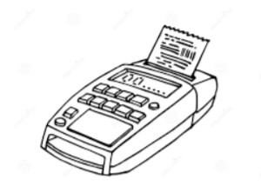
INTRODUCTION
This proposed project “Patient Registration System” has been developed overcome the problems faced in practicing of manual system. A patient registration system is a software that can be used to register the Patients in Community Health Centers, Government hospitals .
This system input the details of patients like their Name,age,registration number,gender etc. and give an OPD slip as output. Also it stores this information in readable text format.

Slide 5
FEATURES AND SCOPE
The main features of this project are as follows:
-> Input the details of patients.
-> Generate the OPD slip with details given by patients.
-> Store the data in a readable text file.
The scope of this project is as follows:
-> Can replace the existing manual registration.
-> Make the registration system easier and compatible to use
-> Management of patient records becomes easy.
-> Overcome the difficulties of the manual system.
-> Errors become minimal.

Slide 6
FUNCTIONS , CLASSES AND LIBRARIES
------------------------------- Functions used : -------------------------------
INPUT- ->To take the input from user i.e. personnel information of patients.
GENERATE- ->To generate the OPD slip. MAIN- ->to do main functioning.
-------------- Class used is named as “Patient”. --------------
----------------- Libraries or header files used: —-----------------------
->iostream.
->iomanip.
->ctype.h.
->fstream.

Slide 7
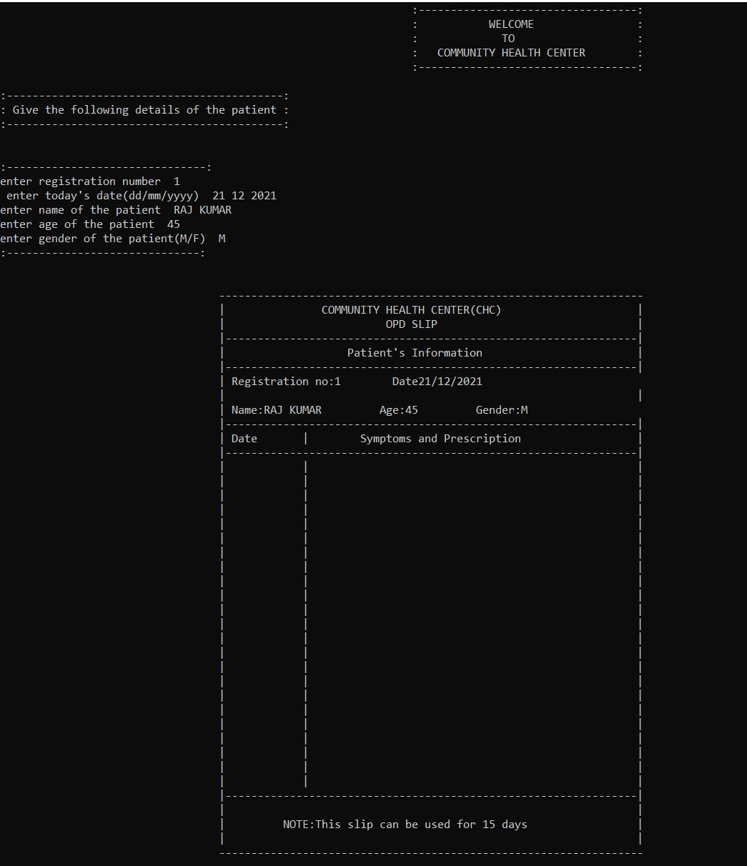
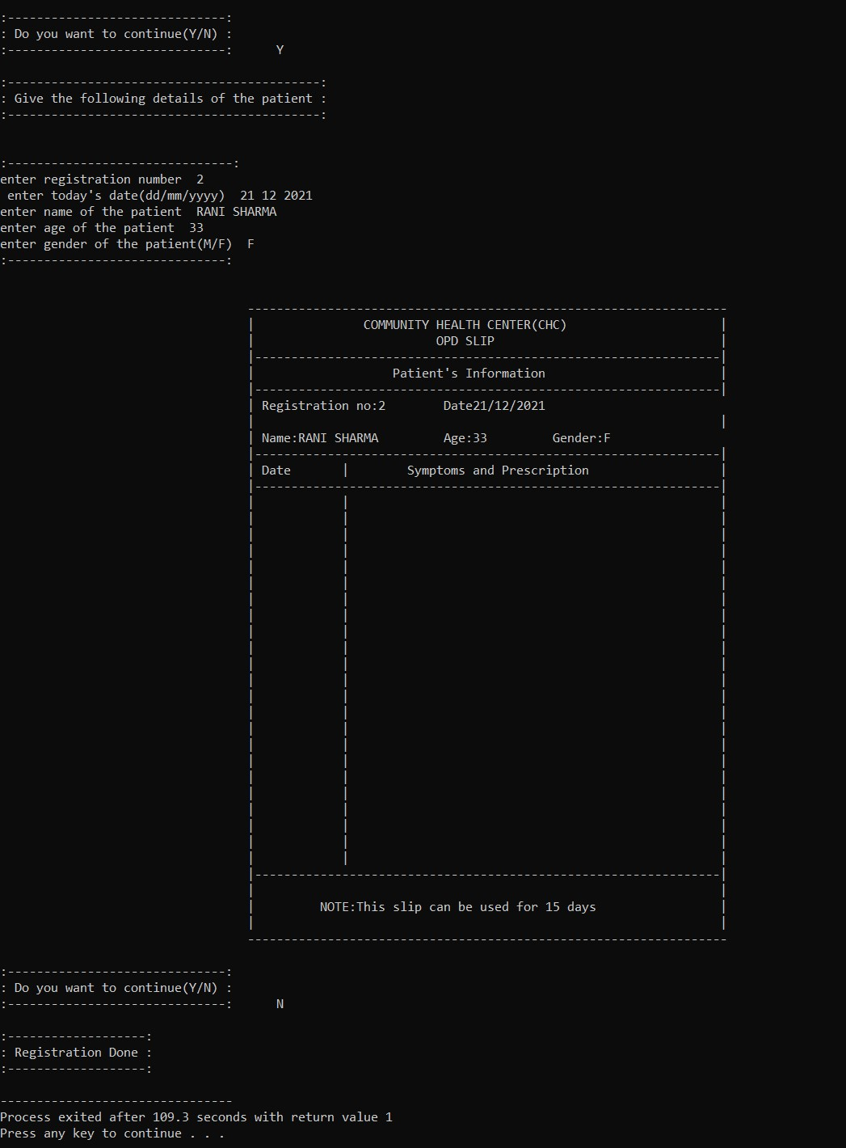
OUTPUT.

Slide 8
Conclusion
Patient Registration System developed to replace the cumbersome manual registration system ,has been designed to achieve efficiency and reduce the time taken to handle registration activity and to get rid of piles of papers.

Slide 9
Thank You

